Slide 1

Sustainable Development in
Latin America and the Caribbean
Carlos de Miguel
Economic Commission for Latin America and the Caribbean
Quito, Ecuador
2012

Slide 2
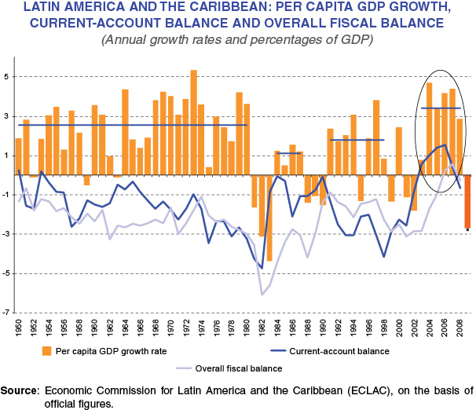
The situation in the region today is quite different from that which existed in 1992
In 1992, the region was emerging from a "lost decade" of low growth, high inflation and restrictions on the balance of payments related to foreign borrowing.
Currently, despite the recent global economic crisis, the region is achieving nearly a decade of relatively high growth.

Slide 3
Latin America and the Caribbean Grows:
5.9% in 2010 and 4.3% in 2011
LATIN AMERICA AND THE CARIBBEAN: PIB GROWTH RATES, 2011
(percentages)
Notes:
En el año en su conjunto se desaceleró el crecimiento. En términos contables Brasil explica el 95% del menor crecimiento de la región en 2011
En la segunda mitad del año se profundizó la desaceleración del crecimiento regional. Contribuyeron:
Menores tasas de crecimiento de las exportaciones, una caída de precios de los principales bienes básicos de exportación de la región (aunque aún a niveles elevados históricamente) y un enframiento de la demanda interna.
En el cuarto trimestre empeoran las expectativas sobre la evolución de la economía regional y crecen las incertidumbres respecto a la economía mundial (en torno a la crisis de deuda –varios países de la zona euro- y la volatilidad de los mercados internacionales)
… con un desempeño heterogéneo en la comparación 2010 / 2011
Brasil: Elevado crecimiento en 2010 generó preocupaciones por un posible sobrecalentamiento => políticas para enfriar demanda interna. Menor expansión de la economía de Brasil explica buena parte del menor crecimiento regional
Pero un número importante de países registró un mayor crecimiento en 2011 que en 2010:
Desastres naturales en 2010 (Chile, Haití).
Mayores precios de petróleo en 2011 (Ecuador, Venezuela, Rep.Bol.de)
Efecto rezagado de recuperación de EEUU en exportaciones y remesas (algunos países de Centroamérica y el Caribe)

Slide 4
Mixed progress has been observed in the sustainability of development
Indicators | 1990 | 2000 | 2005 | 2010
Población (miles de personas, a mitad de año) | 443 032 | 521 429 | 557 038 | 590 082
Población urbana (miles de personas, a mitad de año) | 311 042 | 393 420 | 432 646 | 468 757
Pobreza
Proporción del total (porcentajes) | 48,4 | 43,8 (1999) | 33,2 (2008) | 31,4
Personas (millones) | 204 | 215 (1999) | 183 (2008) | 177
Índice de Desarrollo Humano | 0,624 | 0,68 | 0,703 | 0,728
Distribución del ingreso (coeficiente de Gini x 100) | 53,8 (1989/1992) | 55 (2002) |  | 52 (2006/2009)
Población viviendo en tugurios
Proporción del total (porcentajes) | 33,7 | 29,2 | 25,5 | 23,5
Personas (millones) | 105,7 | 115,2 | 110,1 | 110,8
Población sin acceso a energía
Proporción del total (porcentajes) | 17,8 | 13,4 | 7,8 | 6,4 (2009)
Personas (millones) | 76 | 41 | 43 | 39 (2009)
Población con acceso a fuentes mejoradas de agua potable
Proporción del total (porcentajes) | 85 | 90 | 92 | 93 (2008)
Personas (millones) | 376 605 | 468 992 | 513 000 | 538 089 (2008)

Slide 5
Mixed progress has been observed in the sustainability of development
Indicadors | 1990 | 2000 | 2005 | 2010
Población con acceso a servicios de saneamiento
Proporción del total (porcentajes) | 69 | 75 | 78 | 79 (2008)
Personas (millones) | 304 219 | 392 289 | 435 969 | 458 593 (2008)
Superficie cubierta por bosques ^{f} (porcentajes) | 51,9 | 49,4 | 48,2 | 47,2
Proporción de las áreas terrestres protegidas ^{g} (porcentajes) | 9,7 | 15,3 | 19,5 | 20,3
Oferta de energía renovable ^{h} (porcentajes) | 25 | 21,5 | 22,2 | 23,2 (2009)
Intensidad energética del PIB ^{i} (consumo total de energía —en miles de barriles equivalentes de petróleo— por millón de dólares de PIB a precios constantes de 2000) | 1,6 | 1,53 | 1,5 | 1,45 (2009)
Intensidad de emisiones de CO₂ ^{j} (toneladas por cada 1 000 dólares de PIB a precios constantes de 2000) | 0,65 | 0,62 | 0,60 | 0,58 (2008)
Emisiones de CO₂ por habitante ^{k} (toneladas de CO₂ por habitante por quema de combustibles fósiles y producción de cemento) | 2,3 | 2,6 | 2,6 | 2,9 (2008)
Intensidad de uso de fertilizantes ^{l} (toneladas por 1 000 hectáreas de superficie agrícola) | 11,6 | 17,3 | 21,3 | 23,3 (2008)
Consumo de sustancias que agotan la capa de ozono ^{m} (miles de toneladas de potencial de agotamiento del ozono (PAO)) | 74,6 | 31,1 | 14,5 | 5,4 (2009)

Slide 6
Between 1990 and 2010 poverty fell 17 percentage points, from 48.4% to 31.4%

Slide 7
Between 1990 and 2010 human development index of the region as a whole improved substantially

Slide 8
The region has made ​​significant progress in expanding potable water and sanitation

Slide 9
In the last five years significant progress has been made in controlling deforestation, especially in the Amazon

Slide 10
Regional emissions of ozone-depleting substances have declined steadily over the last 20 years
LATIN AMERICA AND THE CARIBBEAN: CONSUMPTION OF OZONE-DEPLETING
SUBSTANCES, 1990–2009
(Ozone-depleting potential (ODP) tons)
This reflects successful efforts made under the Montreal Protocol
Source: Economic Commission for Latin America and the Caribbean (ECLAC), on the basis of United Nations Millennium Development Goals indicators database based on figures from the Ozone Secretariat of the United Nations Environment Programme (UNEP) [online] http://ozone.unep.org/Data_Reporting/Data_Access/ [date of reference: May 2011].

Slide 11
Strengthening the environmental pillar
Since 1992, environmental legislation has strengthened and institutions dedicated to the environment have been created.
Sustainable development has been established as a concept in public institutions and policy.

Slide 12
As a result, poverty rates should fall in 2011 but indigence rates probably will not, owing to food price inflation

Slide 13
Despite advances in income distribution, the region remains the most imbalanced in the world.

Slide 14
The region has a wide disparity in educational quality between different social classes and between rural and urban populations

Slide 15
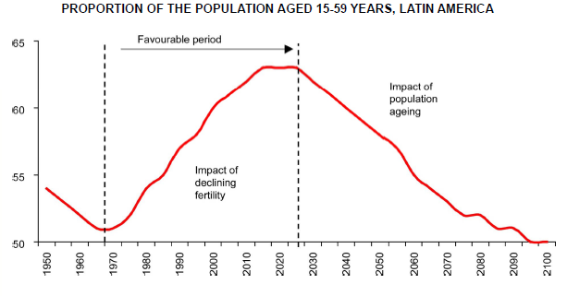
The reduction in fertility has ushered in a period that is favourable to development, since the proportion of the people of economically productive age has increased
Notes:
Con la reducción de la fecundidad se genera un período favorable al desarrollo, conocido como Bono demográfico, en que aumenta la proporción de personas en edad productiva (15 a 59 años) en relación a la de personas en edad de dependencia económica (0-14 años y 60 y más años de edad). Esto implica una fase oportuna para desarrollar capacidades, incrementar la productividad y fortalecer sistemas de protección social.
Sin embargo, este período tiene una duración limitada, y se extingue con el incremento proporcional de la población adulta mayor.
El gráfico muestra que este período favorable para el conjunto de América Latina empezó al principio de la década de 1970, a partir de la fuerte reducción en los niveles de fecundidad, y se estima terminará alrededor del año 2030, a partir del fuerte incremento proporcional de las personas mayores.

Slide 16
Emissions of greenhouse gases in Latin America and the Caribbean have increased steadily since 1990
Between 1990 and 2005, the average annual rate grew 1.2% similar to a global average. CO₂ emissions per capita in LAC have remained relatively stable between 1990 and 2006, however there are significant differences in the region.

Slide 17
Information for decision-making and civil society participation
Despite progress in recent years, the area of environmental statistics requires greater attention, investment and training.
The issue of information use, not only in the region but globally, is how to account for wealth in order to take into account the value of the environment, and its degradation
is how to account for wealth in order to take into account the value of the environment, and its degradation
With regards to technology and environmental information, a challenge in the region is expanding access of existing tools to governments and civil society.
      In many countries, legislation to facilitate the implementation of Principle 10 of Rio Declaration, which deals with access to information and environmental justice and citizen participation is not yet developed or hard of implementation.

Slide 18
International cooperation and improvements in the terms of international trade are not sufficient
OFFICIAL DEVELOPMENT ASSISTANCE GRANTED BY COUNTRIES OF THE DEVELOPMENT ASSISTANCE COMMITTEE, 1990-2008
(Percentages of gross national income of donor countries)
In 2010, ODA provided by developed countries amounted to 0.32% of their GNI, less than half of the percentage target agreed upon.
Source: United Nations, Achieving the Millennium Development Goals with Equality in Latin America and the Caribbean: progress and challenges (LC/G.2460), Santiago, Chile, Economic Commission for Latin America and the Caribbean (ECLAC), 2010.

Slide 19
Strategic Guidlines for Sustainable Development
A. Implement mechanisms to ensure coordination and coherence of public action for the effective incorporation of the principles of sustainable development. Changing production and consumption patterns
B. Take advantage of synergies: search for co-benefits and win-win policy
C. Focus on sustainability of development, welfare, property, investment, natural resource governance

Slide 20
Strategic Guidelines for Sustainable Development
D. Application of Principle 16: internalization of environmental costs and benefits of social and economic decisions, public and private. Green tax reforms
E. Effective implementation of Principle 10: information, participation and justice.
F. Production and dissemination of environmental information and statistics and sustainable development
G. Human capital for sustainability: education, science, culture, technology

